Slide 1
A Defense of Computational Physics
(Popper’s Non-Verifiability vs. Computational Validation)
Patrick J. Roache
hermosa@sdc.org
ASME Verification and Validation Symposium
May 2-4, 2012
Las Vegas, Nevada USA

Slide 2
Popper’s Non-Verifiability vs.
Computational Validation
Karl Popper is usually considered the most influential philosopher of science of the first half (at least) of the 20th century. His assertion that true science theories are characterized by falsifiability has been used to discriminate between science and pseudo-science, and his assertion that science theories cannot be verified but only falsified has been used to categorically reject claims of Validation of computational models. Both of these assertions will be challenged, as well as the applicability of the second assertion to modern computational models such as climate models, even if it were considered to be correct for scientific theories.

Slide 3
background
Karl Popper (1902-1994) Thomas Kuhn (1922-1996)
Kant's problem of demarcation - the central issue of science
...scientific theory (statements) from those of
metaphysics (Kant's concern) or
pseudo-science (Marx, Freud, Adler, astrology)
Popper has less current interest to philosophers but
lasting influence on scientists and engineers
...Validation of computational models (PDE’s)
... well known, not well read

Slide 4
Popular Popper Précis
A scientific theory
[and by extension a computational model]
cannot be verified [validated] i.e. proven to be true.
It can only be falsified [invalidated] i.e. proven to be false.
“falsificationism”
It must be capable (in principle) of being invalidated, i.e. be falsifiable, otherwise it is not a scientific theory but only a pseudo-scientific (or perhaps metaphysic) theory/statement

Slide 5
  examples
Blue Ribbon Panel on Simulation-Based Engineering Science (NSF, 2006; J. T. Oden, chair)
Oreskes, N., Shrader-Frechette, K., and Belitz, K. (1994), “Verification, Validation, and Confirmation of Numerical Models in the Earth Sciences,” Science
Konikow, L. F. and Bredehoeft, J. D. (1992), “Groundwater Models Cannot be Validated,” Advances in Water Resources
recent (2009) submission –
  once a model is not invalidated, it can be used for decision making (!)
Hazelrigg (2003) + Arrow’s Impossibility Theorem, ...

Slide 6
background
importance is remarkable –
“ The Logic of Scientific Discovery “ (Popper, 1934)
well before modern computational modeling (~ 1965)
(last edition 1980, no mention of computation, simulation)
Whatever Popper’s contributions, they were not directed specifically towards Validation of computational models
but to scientific theories in general.
"All x are y“

Slide 7
goals and approach
my real goal is probably unattainable:
falsificationism
instead, a down-to-earth rebuttal
no hope of changing a true believer's mind
but to give support to anyone who needs to address the issue
(gotcha! by reviewers, funders, regulatory agencies, stakeholders...)
and get on with their work
will critique at 3 levels
philosophy of science
empirical data on how science is conducted in the 21st century
non- applicability to the Validation of computational models

Slide 8
Level (a)
Problems for the Philosophy of Science
Popper did not quite invent falsifiability
nor substitute it for verifiability
but he emphasized it to the exclusion of all else (i.o.i.)
he examined both proposed by the logical positivists
( "conclusively decidable“ or "completely decidable“)
rejected verifiability & accepted (adopted ) falsifiability

Slide 9
level (a)
Popper quoting the logical positivists -
"The criterion of demarcation inherent in deductive logic ... must be capable of being finally decided, with respect to their truth and falsity; we shall say that they must be 'conclusively decidable.’ This means that their form must be such that to verify them and to falsify them must both be logically possible."

Slide 10
level (a)
“A sentence (or a theory) is empirical-scientific
if and only if it is falsifiable” (Popper)
very strong position, not supportable
not every non-falsifiable statement is pseudo-science (unless it is posing as science)

Slide 11
level (a)
“A sentence (or a theory) is empirical-scientific
if and only if it is falsifiable” (Popper)
fundamental orientation of Popper and contemporaries
  minimalist absolute statements to settle vexing questions
  esthetic of economy is evident
  economy is lost in the ensuing discussions, rebuttals, refutations, clarifications, and elaborations, ...
  typical of legalistic definition vs description
    (causes problems in Guides and Standards, also)

Slide 12
level (a)
“A sentence (or a theory) is empirical-scientific
if and only if it is falsifiable” (Popper)
descriptions are more understandable, helpful, realistic, and honest , in my opinion
Hansson [SEP] cited 14 later philosophy papers that have offered lists of characteristics, usually 5-10 items, rather than a single criterion, to identify a pseudo-science or [better] pseudo-scientific practice.
His own list of 7 items follows (see [SEP] for elaboration).

Slide 13
level (a) Pseudo-science lists
• Belief in authority
• Nonrepeatable experiments
• Handpicked examples
• Unwillingness to test
• Disregard of refuting information
• Built-in subterfuge
• Abandonment of explanations without replacement
Besides rejection of minimalism and legalistic definition, note focus on practice (Kuhn) rather than science statements.

Slide 14
level (a)
"Is Intelligent Design (aka Creationism) a Pseudo-Science?"
Better question (Kasser)
"Do advocates of Intelligent Design behave pseudo-scientifically?
(Yes 7/7)

Slide 15
level (a)
Different demarcation criteria often lead to same rejections
  observed by Kuhn (1974), explained by Hansson (2009)
Consider theory of biological evolution
  not pseudo-science but
  Popper long disagreed - "survivors survive"
  [pseudo-science behavior in glib explanations]

Slide 16
level (a)
an annoying problem today of inconsistent terminology
Popper did not use the word Validation nor even Validate (except in a few obscure footnotes) but rather verify
His philosophy has been used to rebut claims of Validation of computational models
(or to preemptively disallow claims)
In modern usage, one speaks of the area of "V&V" for Verification and Validation
The distinction is not controversial to practitioners

Slide 17
level (a)
Verification of Codes
  code does what manual says
Verification of Calculations (Solutions)
  error and uncertainty estimates for problem of interest
Validation
  comparison with physical reality

Slide 18
level (a)
Verifications ~ (mere) mathematics
Validations ~ physics (physical laws)
Certifications ~ project-specific engineering management
etymologies
  verify ~ truth (Latin)
  validate ~ strength (Old English)
  of no consequence, especially to
  technical terms

Slide 19
level (a)
Other philosophical problems with Popper’s demarcation
statistics
science areas unlike physics
  pharmacology
  nutrition
  social sciences
  linguistics (theories)
  cosmology (real doubts)
  ...

Slide 20
level (a)
Surely Popper’s demarcation of falsifiability will work for astrology!

Slide 21
level (a)
Surely Popper’s demarcation will work for astrology!
Not so fast.
astrology now (post-Popper) has been conclusively falsified
therefore astrology should not be categorized as pseudo-science by Popper's demarcation
Popper claimed Wittgenstein's proposal for demarcation could not identify astrology as pseudo-science, and
this was evidence that Wittgenstein's demarcation criterion could not be taken seriously

Slide 22
Level (b). Empirical Data on How Science is Done.
Falsificationism Falsified
Hansson (2006), "Falsificationism Falsified“
Examined all 70 articles in Nature in year 2000 (empiricism!)
Conceptual analysis of Popper's falsificationism, dividing the central thesis into several components
Few articles do or could fit “All A are B” structure
  eliminates explorative research which
  "proceeds open-endedly without any preconceived categorization of possible research outcomes” 49/70
69/70 did not fit Popper’s paradigm of
science-by-hypothesis testing (unarguably 67/70 )

Slide 23
level (b)
What is a falsificationist to do?
Deny the quality of the research ?
Perhaps label 69 of 70 articles in Nature as pseudo-science?
Hansson – this confirms Ernest Nagel (1979):
Popper's "conception of the role of falsification in the use and development of theories is an oversimplification that is close to being a caricature of scientific procedure.“
Falsificationism has been falsified empirically.

Slide 24
Level (c). Critique of Popper's Philosophy to Validation in Computational PDE Modeling
Popper [1, p. 444]
“... The statement ‘this container contains water’ is a testable but non-verifiable hypothesis, transcending experience.”

Slide 25
Level (c). Critique of Popper's Philosophy to Validation in Computational PDE Modeling
Popper [1, p. 444]
“... The statement ‘this container contains water’ is a testable but non-verifiable hypothesis, transcending experience.”
I would add, transcending common sense.
I can tolerate Popper’s position, given his perspective and intellectual tradition,
but I cannot understand how practical scientists and engineers could take this stuff seriously.

Slide 26
level (c). Validation Modeling
Popper also agreed with Hume that there is no logical reason to prefer an extensively tested theory to an untested theory.
... impossible to take this seriously.

Slide 27
level (c). Validation Modeling
Maybe we cannot adequately model
  underground nuclear waste disposal methods
  climate changes
but that evaluation should not hinge on a philosophy of science that equally leads to the conclusion that we cannot say with confidence that a cup contains water, or that a tested theory is preferable to an untested theory!

Slide 28
level (c). Validation Modeling
OK, Disregard all the critiques above.
Say we accept Popper's philosophy, that only falsifiability reigns and there is no verifiability of any scientific theory.
Say we ignore Hansson's empirical demonstration, and the intuition of practicing scientists and engineers, that Popper's prescription of how science is done or should be done is,
in fact, not accurate.
A question remains: Is Popper's philosophy as usually stated applicable to modern computational PDE modeling?

Slide 29
level (c). Validation Modeling
Is Popper's philosophy as usually stated applicable to modern computational PDE modeling?
NO.

Slide 30
level (c). Validation Modeling
Popper was concerned with Truth of a scientific theory.
Is theory equivalent to computational PDE model?
Some say no, but we accept at least a parallel
Level (c-1).
Inclusion of Popper's Numerical Universality in Validation
Level (c-2).
Popper's Truth vs Validation Accuracy

Slide 31
level (c-1). Numerical Universality
Falsificationists ignore Popper’s distinction between
strict universality [∞] & numerical universality [enumerable]
Latter is verifiable according to Popper himself, and it is the appropriate association for modern Validation
In normative V&V practice [15-24], Validation is claimed only for a finite number of experimental conditions
If a good model Validation agrees with experiments at all the set points tested, then it qualifies for numerical universality,
therefore it is verifiable (Popper) or Validated (modern)

Slide 32
level (c-1). Numerical Universality
Any extension of Validation results towards Popper's concept of strict universality, implying a continuum (interpolation), is (arguably) not part of Validation per se
(i.e., it is not part of the Validation exercise, but Application)

Slide 33
level (c-2). Truth vs. Accuracy
Does Validation of a computational PDE model imply Truth of the model?
Can Newton’s laws of motion and Einstein’s relativity
both be true?
They surely are both accurate in their respective domains.
"There could be no fairer destiny for any ... theory than that it should point the way to a more comprehensive theory
in which it lives on, as a limiting case.”
Is Newton false? Untrue? (Popper’s concern was Truth.)

Slide 34
level (c-2). Truth vs. Accuracy
Validation is not concerned with "the whole truth about a phenomenon"
the modest and realistic goal of Validation is accuracy
defined for specific metrics and parameter domains
Truth for non-binary questions is fuzzy
SEP: “It would be impossible to survey all there is to say about truth in any coherent way.”
accuracy can easily be well defined

Slide 35
level (c-2). Truth vs. Accuracy
Truth questions can be appropriate in computational PDE modeling.
  e.g., groundwater flow models
  existence of an unseen fracture can be susceptible to a yes/no truth test
but most modeling evaluations are simply accuracy issues

Slide 36
level (c-2). Truth vs. Accuracy
Limiting Validation to mere accuracy does not necessitate a utilitarianism philosophy for science theories

Slide 37
A Provocative Example of Validation of a Computational Model
well-known astronomical model used for computations
predictive accuracy well established
arguably used longer than any other scientific theory or model

Slide 38
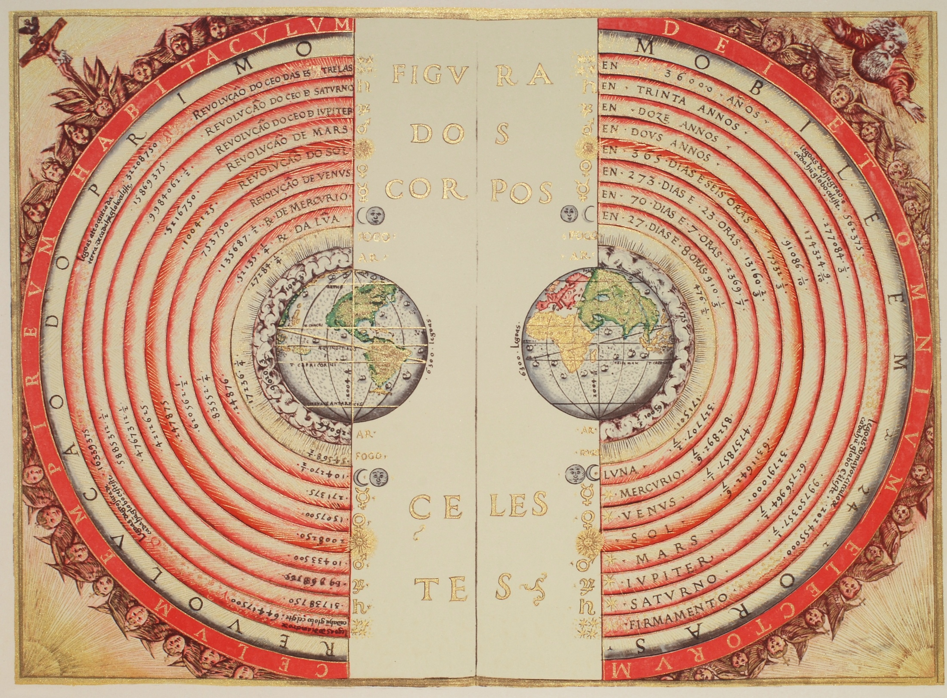

Slide 39
Validation of Ptolemaic Model of Solar System
Ptolemy of Alexandria (~ 100 – 170 CE)
geometer and acknowledged as greatest of the ancient astronomers
theory described in his Syntaxis (later Almagest in Arabic)
also an astrologer (wrote Tetrabiblos)

Slide 40
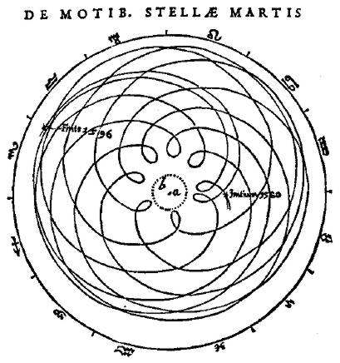

Slide 41
Validation of Ptolemaic Model of Solar System
Ptolemaic model is a bit complicated
based on geocentric rotation of planets
80 little gear-like rotations and counter-rotations
  epicycles moving along larger deferents
  account for retrograde motions
as science theory it was supplanted by Copernicus view (1543, heliocentric) as demonstrated by Galileo in 1609
So the Ptolemaic Model is "not true”
Model was falsified, therefore it was not pseudo-science
It is just not true; false, wrong

Slide 42
Validation of Ptolemaic Model
Object of (ancient) astronomy was practical, constructing
  local clocks
  calendars
  navigation aids
By Ptolomey’s model,
  position of sun and moon “utterly predictable” (Deakin)
  eclipses were explained and foretold

Slide 43
Validation of Ptolemaic Model
astrologers continued to use it for another hundred years
even past Newton
it was easier to use
it was accurate
as a computational model, in our terminology, it was
Validated
but false,
falsified

Slide 44
Validation of Ptolemaic Model
"By tinkering [tuning, calibrating] with the relative sizes of epicycle and deferent, with the planet's speed on the epicycle, and with the epicycles’ speed along the deferent, early astronomers were able to bring this "epicyclic" motion into fairly good agreement with the observed paths of the planets in the sky. Moreover, the model had good predictive power, at least to the accuracy of observations at that time.“
Chaisson and McMillan (2008)

Slide 45
Validation of Ptolemaic Model
Galileo's demonstration of the UnTruth of the model hinged on one observation by telescope
  existence of full phases of Venus

Slide 46
Validation of Ptolemaic Model
Galileo's demonstration of the UnTruth of the model hinged on one observation by telescope
  existence of full phases of Venus
This was not a Validation criterion for the model users
(parallels in modern computational PDE models)

Slide 47
Validation of Ptolemaic Model
Copernicus had still clung to the idea of circular motions (Platonic perfection)
"Thus, he [Copernicus] retained unnecessary complexity and actually gained little in predictive power over the geocentric model."

Slide 48
Validation of Ptolemaic Model
Other reasons for not rejecting Truth of Ptolemaic model
Galileo explained new observation of phases of Venus
but contradicted an older observation –
  lack of stellar parallax
other reasons
  sense of motion, action at a distance, we are not spun off
  (not theological egocentricism: not center but bottom)
for a century or two (debatably) the jury was out on UnTruth
but nobody could argue with the accuracy, i.e. Validation

Slide 49
a cousin of falsifiability
George E. P. Box (1987) on statistical models -
"Essentially, all models are wrong, but some are useful."

Slide 50
a cousin of falsifiability
George E. P. Box (1987) on statistical models -
"Essentially, all models are wrong, but some are useful."
=> no need for falsification !
Better – all models are just models; some are really good
a model is not just a formula like perfect gas law PV=RT
model includes the domain of application (e.g. non-dissociated gas)
Why pick on "models" ?

Slide 51
summary
Popper’s “falsifiability only” as usually presented
is not defensible philosophically
is not used significantly in modern science practice
is not normative of modern science practice
is neither applicable* to computational PDE modeling
nor endorsed by most modeling practitioners
* Popper’s category of numerical universality is applicable and
does allow verifiability (i.e. contradicts “falsifiability only”)

Slide 52
Popper’s falsificationism | Computational Physics Validation
involves science theories | involves computational models
concerned with Truth | concerned with accuracy
ambitious | modest
surprising predictions are valued | surprising predictions are suspect
goal of universality | limited domain
Kuhn’s “crisis” or “revolutionary science” | Kuhn’s “normal science”

Slide 53
last gasp
If Popper’s “falsifiability only” is applicable to computational PDE modeling, it is not less applicable to scientific theories.
His position is clear:
“every scientific statement must remain tentative forever.”
Give up agonizing over what he or we may mean by Truth
(cont.)

Slide 54
last gasp
Validation of computational PDE models is in same category as
Newton’s laws of motion and gravity
Einstein’s theories
entropy
Darwinian evolution (once, Popper said pseudo-science)
conservation of mass
Fourier heat conduction, etc.
We computational modelers are in good, respectable company.

Slide 55
Unrelated – errata for 2009 book
“Fundamentals of Verification and Validation”
Eq. 5.10.6.1 (pages 135 and 452)
The denominator should be {f2 - f1}, not {f2 - f3}.
(Correct in the 1998 edition.)
Eq. 11.12.3.2 (pages 365 and 454)
The + sign should be a - sign.
See www.hermosa-pub.com/hermosa for other Errata and Addenda.

Slide 56
This slide presentation is available (no cost) at www.hermosa-pub.com/hermosa
For citations, use
Roache, Patrick J. (2012), A Defense of Computational Physics, Hermosa Publishers, New Mexico USA
100 page booklet
Available through Amazon.com
$12.50 hardcopy
$ 9.50 Kindle e-Book
Questions or comments ?

